Slide 1
Dr Angela Binda AMT MD CP-HIV DrPH

Slide 3
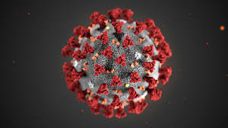
A family of corona viruses which includes other viruses such as MERS, SARS and milder versions causing the common cold.
2. So far the medical consensus seems to be that it is more transmissible but less deadly than SARS.

Slide 4
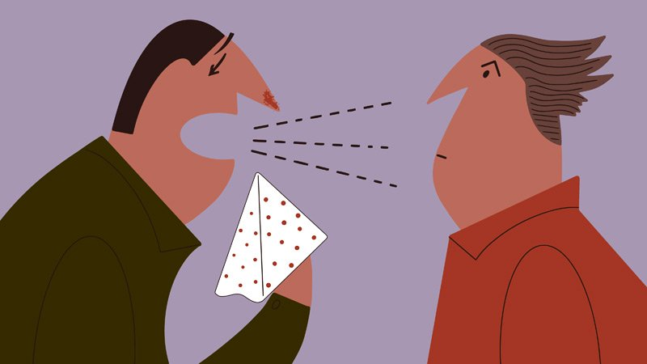
3. Evidence also suggest that the human to human transmission seems to be higher than that of SARS.
4. Direct transmission is mostly via droplets from an infected person over a short distance such as when a person coughs or sneezes.

Slide 6
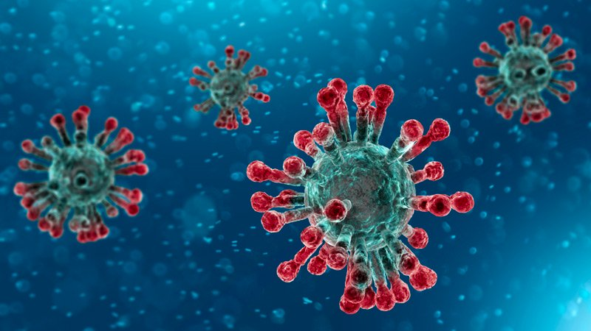
IT IS NOW CLASSIFIED AS A PANDEMIC
Statistics as of 13-03-2020
Globally 1358 038 confirmed with 4990 deaths and
Recovered 70 427
In the Caribbean
Cuba – 3
St Martin -2
Guyana – 1
Jamaica – 2
St Bart's -1
St Vincent and the Grenadines – 1
Trinidad and Tobago - 1

Slide 7
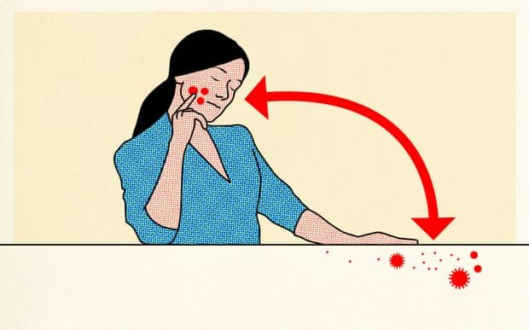
5. If these droplets come in contact with eyes, nose and mouth directly or indirectly though hands that have come into contact with these droplets the individual may become infected

Slide 8
6. There is no evidence to suggest that the virus is air borne
7. It can also transmit through surface contact from which masks offer no protection
8. The person is most infectious when they display symptoms

Slide 9
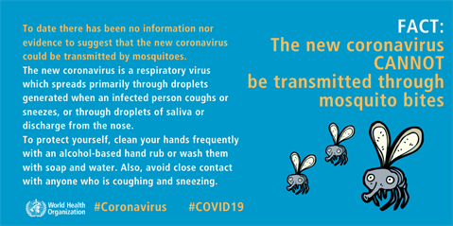

Slide 10
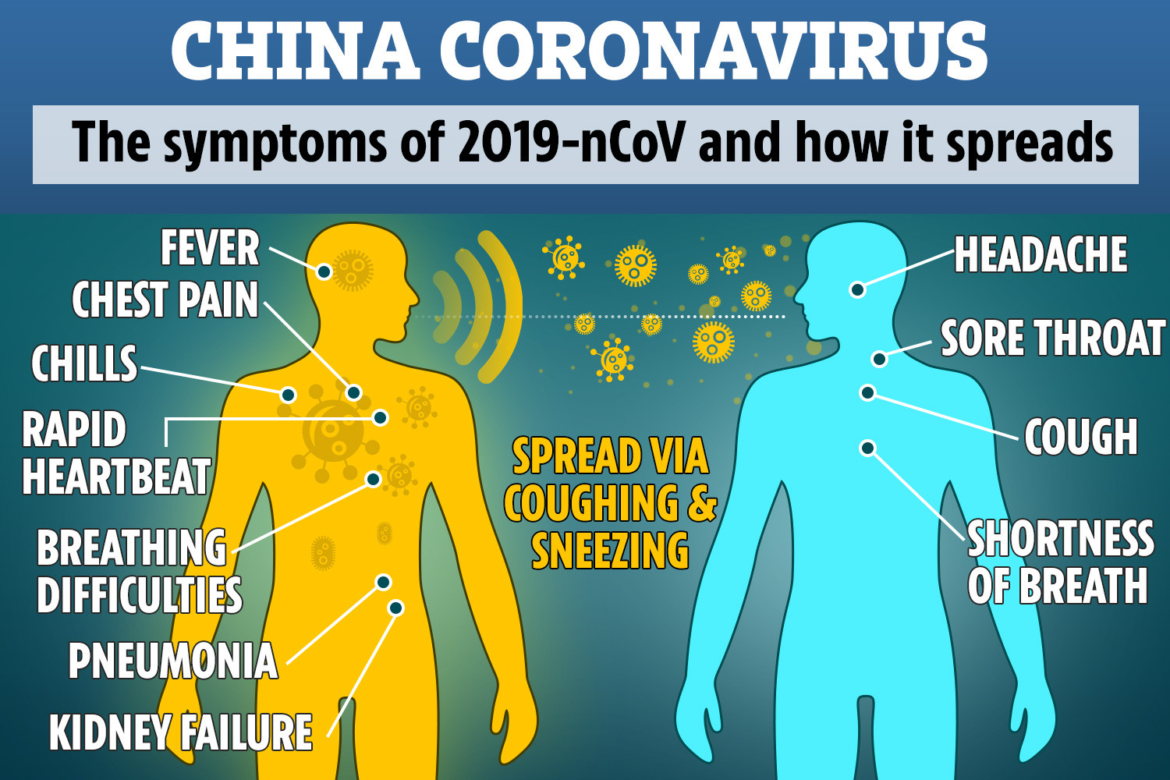

Slide 12
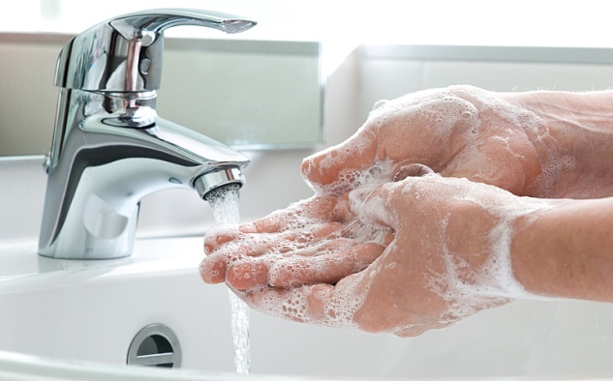
HOW TO PROTECT YOUR SELF
Wash your hands frequently
Regularly and thoroughly clean your hands with an alcohol-based hand rub or wash them with soap and water.
Why?
Washing your hands with soap and water or using alcohol-based hand rub kills viruses that may be on your hands.

Slide 13
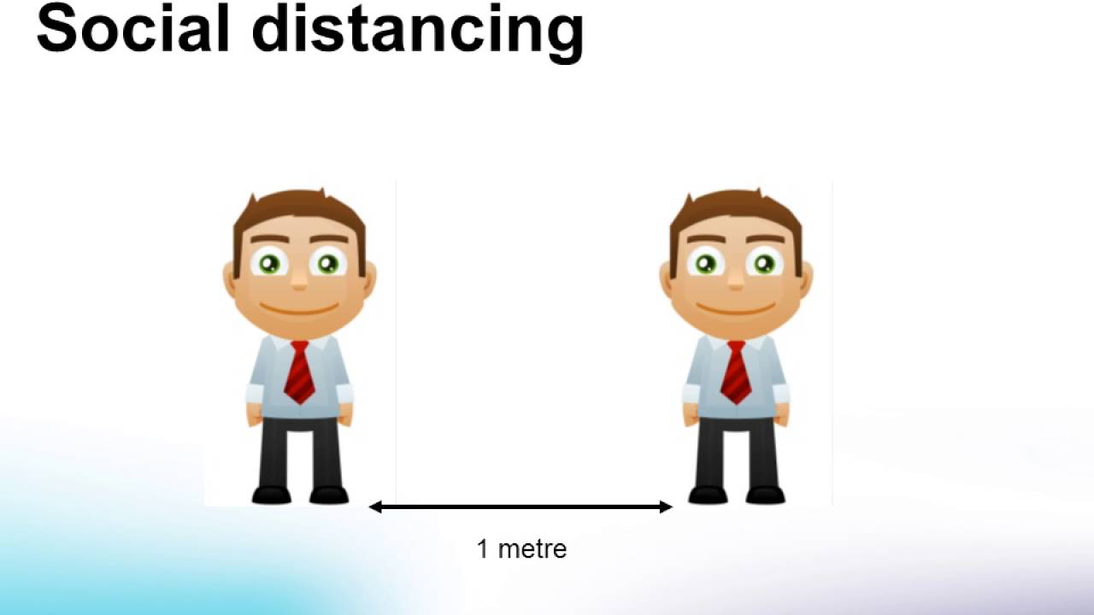
2. Maintain social distancing
Maintain at least 1 metre (3 feet) distance between yourself and anyone who is coughing or sneezing.
Why?
When someone coughs or sneezes they spray small liquid droplets from their nose or mouth which may contain virus. If you are too close, you can breathe in the droplets with the virus.

Slide 15
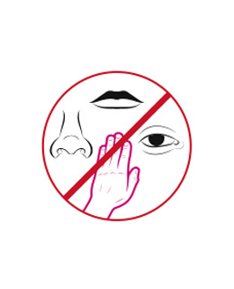
3. Avoid touching eyes, nose and mouth
Why?
Hands touch many surfaces and can pick up viruses. Once contaminated, hands can transfer the virus to your eyes, nose or mouth. From there, the virus can enter your body and can make you sick.

Slide 16
4. Practice respiratory hygiene
Make sure you, and the people around you, follow good respiratory hygiene. This means covering your mouth and nose with your bent elbow or tissue when you cough or sneeze. Then dispose of the used tissue immediately.
Why?
Droplets spread virus. By following good respiratory hygiene you protect the people around you from viruses

Slide 18
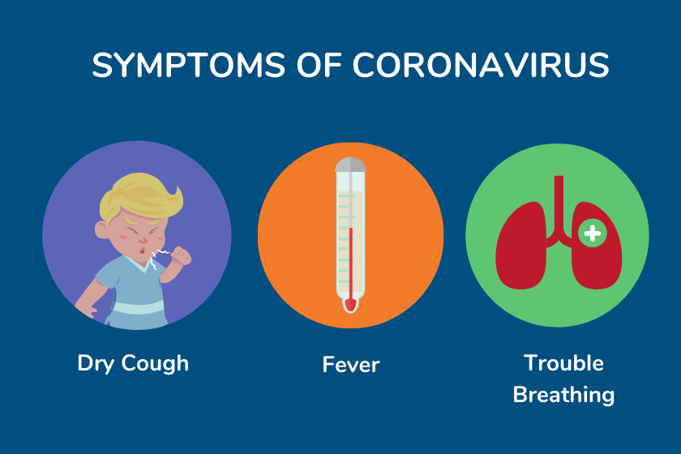
5. If you have fever, cough and difficulty breathing, seek medical care early
Stay home if you feel unwell. If you have a fever, cough and difficulty breathing, seek medical attention and call in advance. Follow the directions of your local health authority.
Why?
Calling in advance will allow your health care provider to quickly direct you to the right health facility. This will also protect you and help prevent spread of viruses and other infections.

Slide 19
6. Stay informed and follow advice given by your healthcare provider
Stay informed on the latest developments about COVID-19. Follow advice given by your healthcare provider.
Why?
The local authorities will have the most up to date information on whether COVID-19 is spreading in your area. They are best placed to advise on what people in your area should be doing to protect themselves.

Slide 20
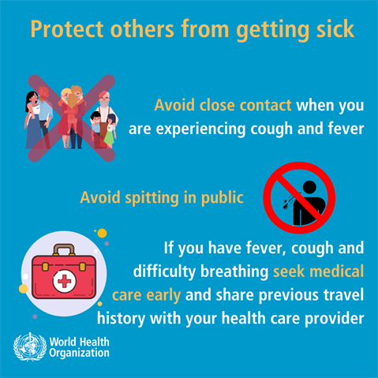

Slide 21
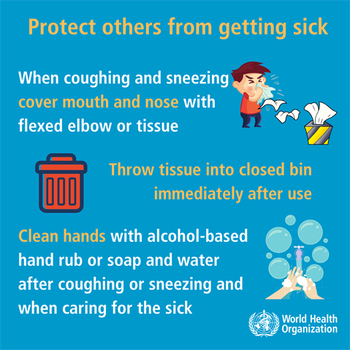

Slide 22
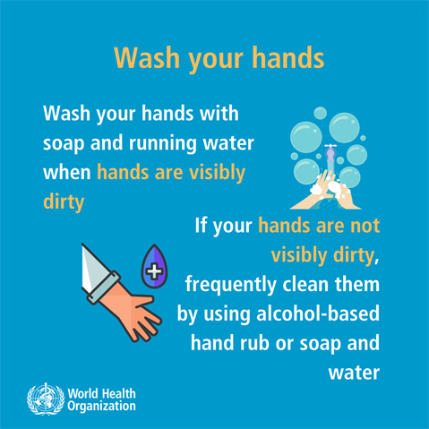

Slide 25
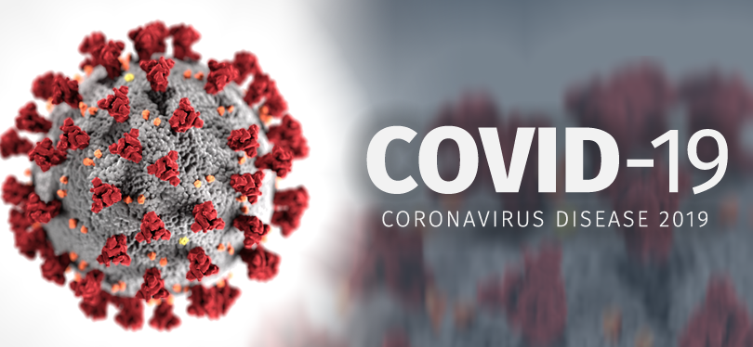
PREVENTION IS BETTER THAN CURE
WE CAN DO THIS

Slide 26
WHAT IS COVID-19 ?

Slide 27
WHAT IS A PANDEMIC?

Slide 28
WHAT ARE THE SYMPTOMS OF COVID-19?

Slide 29
WHAT SHOULD U DO IF YOU OR SOMEONE HAS VIRAL SYMPTOMS?

Slide 30
WHAT SHOULD YOU DO TO AVOID GETTING COVID-19?

